Slide 1
Origins of Terms of Trade
Alan V. Deardorff
University of Michigan
For presentation at Grinnell College
April 6, 2017

Slide 2
Glossary

Slide 3
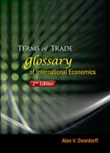
Deardorff’s Glossary of International Economics:
The Terms of Trade and Other Wonders
Intro
Terms, with search
Bibliography
Figures
Lists
Origins

Slide 4
Origins of Selected Terms
I’ll look here the starred items below, and others if there’s time
*CES function
Dixit-Stiglitz utility
*Edgeworth box
(*)Gravity model
*Harberger triangle and Deadweight loss
Lerner diagram
Marshall-Lerner condition
*Offer curve
*Terms of trade
For each I’ll look at the origin of both
the idea (the substance), and
the name.

Slide 5
Origins of “CES function”

Slide 6


Origins of “CES function”
Definition
With arguments x = (x₁, … , x_{n} )
where a_{i}, A are positive constants and
is the elasticity of substitution.

Slide 7
Origins of “CES function”
Substance introduced by
Arrow, et al. 1961.
Motive: To "derive a mathematical function having the properties of
(i) homogeneity,
(ii) constant elasticity between capital and labor, and
(iii) the possibility of different elasticities for different industries.”
Note that it was a production function, not a utility function.

Slide 8
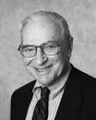


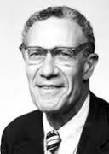
Origins of “CES function”
Arrow, K.J., H.B. Chenery, B.S. Minhas, and R.M. Solow. 1961. "Capital-Labor Substitution and Economic Efficiency," Review of Economics and Statistics 43(3), (August), pp. 225-250.

Slide 9
Origins of “CES function”
Named CES Function by the authors
Other names:
"homohypallagic" function (Minhas 1962)
From Greek: homo = same, hypallage = substitution
"SMAC function” (Mukerji 1963)
Basis of (Spence-)Dixit-Stiglitz utility function, allowing number of goods (varieties) be variable

Slide 10
Origins of “Edgeworth box”

Slide 11
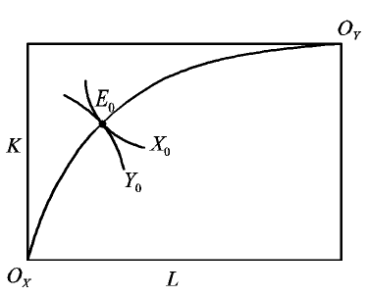
Origins of “Edgeworth box”
Isoquants
This shows an Edgeworth production box, with isoquants for producing goods X and Y from factors L and K.
The same figure with different labels shows consumption of two goods for two consumers

Slide 12
Origins of “Edgeworth box”
O₂
Indifference Curves
Contract Curve
Y
U₁
U₂
O₁
X

Slide 13
Origins of “Edgeworth box”
Also called “Edgeworth-Bowley box”
See however: Tarascio, Vincent J. 1972. "A Correction: On the Geneology of the So-Called Edgeworth-Bowley Diagram," Western Economic Journal 10, (June), pp. 193-197.

Slide 14
Origins of “Edgeworth box”
First drawn by Pareto (1906), who wrote in French.
Based, but only very partially, on Edgeworth (1881).
Got “-Bowley” name because Bowley (1924) combined indifference maps for two consumers, each turned 90 degrees in opposite directions.
Bowley did not claim originality.

Slide 15
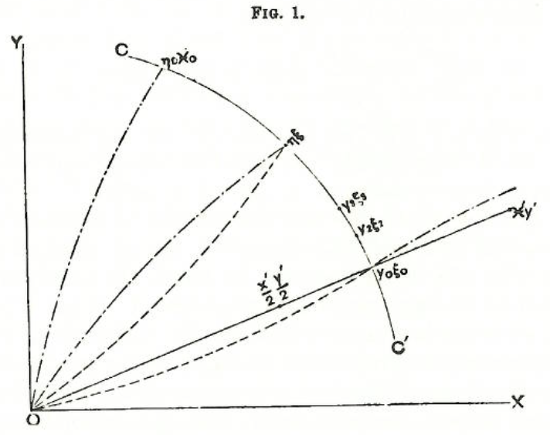
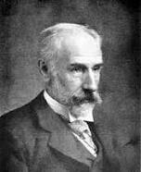
Edgeworth (1881)
“Locus it is here proposed to call the contract curve.”
“Curves of indifference.”
Edgeworth, Francis Ysidro. 1881. Mathematical Psychics: As Essay on the Application of Mathematics to the Moral Sciences.

Slide 16

Origins of “Edgeworth box”
Edgeworth did
Define the contract curve with an equation:
“It may be shown from a variety of points of view that the locus of the required point is
which locus is it here proposed to call the contract-curve.”
Draw the contract curve, but without showing tangency of indifference curves. (Shape suggests he may not have understood that.)
(Equality of marginal rates of substitution)

Slide 17
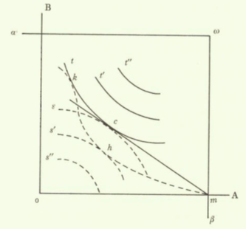
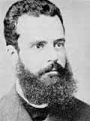
Pareto (1906)
Pareto, Vilfredo. 1906. Manual of Political Economy.
Manuel d’Économie politique

Slide 18
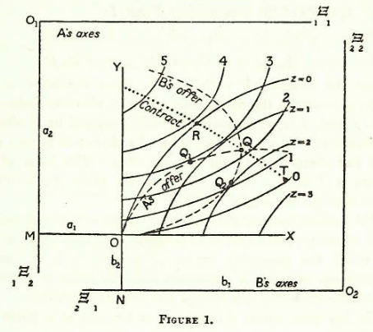
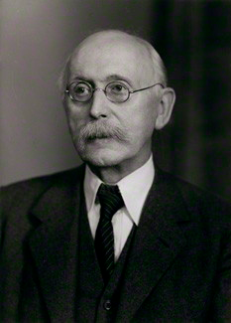
Bowley (1924)
Bowley, Arthur. 1924. The Mathematical Groundwork of Economics: An Introductory Treatise, Oxford: Clarendon Press.

Slide 19
Origins of “Edgeworth box”
Both production and consumption boxes are called Edgeworth boxes, though Edgeworth never drew either.
Better name might be Pareto box.

Slide 20
Origins of “Edgeworth box”
But Pareto is already well recognized:
“Pareto criterion”
“Pareto distribution“
“Pareto improving“
“Pareto optimal“

Slide 21
Origins of “Edgeworth box”
Who called it the Edgeworth Box?
Not Pareto or Bowley
I’ve searched in Google Scholar for
“Edgeworth box”
“Edgeworth-Bowley box”
“box diagram”
“Edgeworth” and “box”

Slide 22
Origins of “Edgeworth box”
Search results: nothing until:
Stolper and Samuelson (1941)
“This is done in Fig. 2 which consists of a modified box diagram long utilised by Edgeworth and Bowley in the study of consumers' behaviour.”

Slide 23
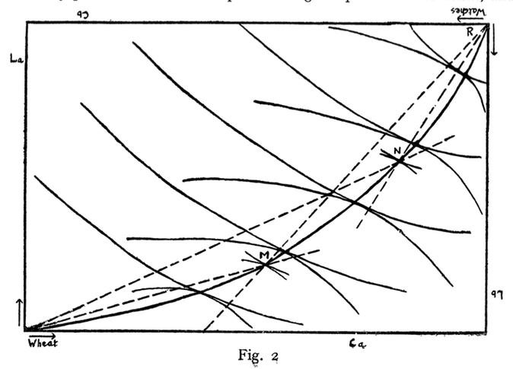
Stolper, Wolfgang and Paul A. Samuelson. 1941. "Protection and Real Wages," Review of Economic Studies 9(1), (November), pp. 58-73.

Slide 24
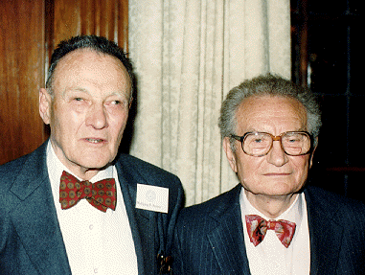
Origins of “Edgeworth box”
Who should have credit for the idea?
As applied to consumption: Pareto
As applied to production: Stolper and Samuelson (if they need further recognition)

Slide 25
Origins of “Edgeworth box”
My conclusion on who (mis-)named it the Edgeworth(-Bowley) Box?
Stolper and Samuelson, in their 1941 paper which was surely written and circulating long before it was published.
Samuelson may have learned of it from others as oral tradition.

Slide 26
Origins of “Gravity Model”

Slide 27
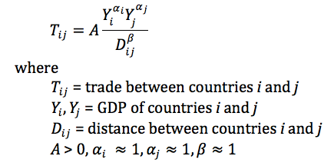
Origins of “Gravity Model”
The standard gravity model of trade:

Slide 28
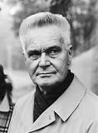
Origins of “Gravity Model”
Substance (but not name) introduced to trade independently by
Tinbergen, Jan. 1962. Shaping the World Economy,
and also by
A Finnish team that included:
Pöyhönen, Pentti. 1963. "A Tentative Model for the Volume of Trade Between Countries," Weltwirtschaftliches Archiv
Pulliainen, Kyosti. 1963. "A World Trade Study: An Econometric Model of the Pattern of the Commodity Flows in International Trade in 1948-1960," Ekonomiska samfundets tidskrift

Slide 29
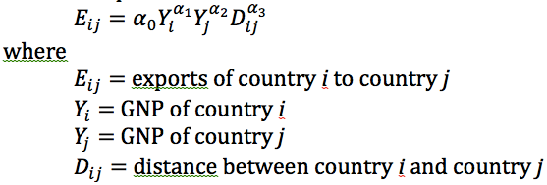
Origins of “Gravity Model”
Tinbergen’s version:
(very much like the basic gravity equation today)

Slide 30
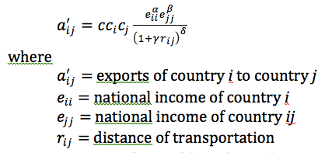
Origins of “Gravity Model”
Pöyhönen’s version:
Differences:
Notation
Country fixed effects
Role of distance

Slide 31
Origins of “Gravity Model”
Naming of the Gravity Model
None of these authors called it this
Tinbergen and Pöyhönen do not use the word gravity or note any analogy with gravitation

Slide 32
Origins of “Gravity Model”
Pulliainen does note the connection with gravity:
“The results of our empirical study show that the structure of international trade is capable of description in terms of gravitational theory. A formal analogy to the theory of gravitation (a=b=1, d=2) is attainable – provided one feels it is desirable…”

Slide 33
Origins of “Gravity Model”
But another early user of the model was Linnemann, Hans. 1966. An Econometric Study of International Trade Flows. But
“Some authors emphasize the analogy with the gravitation law in physics, and try to establish that [α₃=−2]. We fail to see any justification for this.”

Slide 34
Origins of “Gravity Model”
First to call it the Gravity Model: Waelbroeck, J. 1965. "On the Structure of International Trade Interdependence," Cahiers Economiques de Bruxelles

Slide 35
Origins of “Gravity Model”
Waelbroeck
“Hypothesis 2: The gravity model”
“There is, as has been pointed out, an odd similarity between formulae (6) and (7) and the law of gravity, with Y_{i} and Y_{j} playing the role of masses, and this justifies christening the model as the gravity, or G, model.

Slide 36
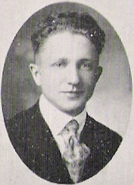
Origins of “Gravity Model”
Earlier origins outside of trade: Others used gravity-like models in other fields earlier:
Substance
Zipf, George Kingsley 1946, “The P₁P₂/D Hypothesis” for inter-city movements of freight, persons, information, etc.
and
Stewart 1947 for “Distribution and Equilibrium of Population,” calling it “potential.”

Slide 37
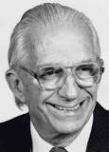
Origins of “Gravity Model”
Earlier origins outside of trade
Name
Bramhall & Isard 1960 on regional science: “gravity, potential, and spacial interaction models -- which for short we shall term gravity models.”

Slide 38
Origins of “Harberger triangle” and “Deadweight loss”

Slide 39
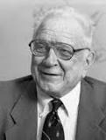
Origins of “Harberger triangle” and “Deadweight loss”
Diagram in the context of a small-country tariff
P
S
P_{aut}
Harberger triangles
P₁=P_{W}+t
t
a
c
b
d
P₀=P_{W}
measure
D
“Dead Weight Loss”
M₁
S₀
S₁
D₁
D₀
Q
M₀

Slide 40

Origins of “Harberger triangle” and “Deadweight loss”
Harberger triangle
Best source is Hines (1999)
Idea goes back to Dupuit (1844) and, independently, Jenkin (1871-72)
Harberger made repeated use of it, starting in 1954
It wasn’t clearly called Harberger Triangle until 1976, but then by more than one author

Slide 41
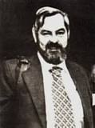
Origins of “Harberger triangle” and “Deadweight loss”
Harberger triangle applied to trade
First done by Johnson (1958)
The tool was used frequently, but without the Harberger name until 1989
Then suddenly the “Harberger triangle” was mentioned in a trade context by Tullock (1989), Williamson (1990), and Vousden (1991)
But trade economists have tended to prefer “deadweight loss”

Slide 42

Origins of “Harberger triangle” and “Deadweight loss”
Deadweight loss
Term was introduced to literature on both taxes and trade by Samuelson (1952):
“and the "deadweight loss" resulting from interferences with perfect competition.”
His use of quotation marks suggests (oddly) that term was not yet standard

Slide 43
Origins of “Harberger triangle” and “Deadweight loss”
Deadweight loss
Prior to Samuelson, I’ve only found “dead loss” for this purpose:
Earliest was Bickerdike (1906):
“It can be shown geometrically that the "loss" Aka comprises all the dead loss involved in the reduction of imports, including the waste of energy.”

Slide 44
Origins of “Harberger triangle” and “Deadweight loss”
Deadweight loss
After Samuelson (1952), several more uses by Samuelson in the 50s
Then 26 uses of “deadweight loss” in 1961-70, mostly by others

Slide 45
Origins of “Harberger triangle” and “Deadweight loss”
No uniformity regarding
Deadweight loss
Dead-weight loss
Dead weight loss
Samuelson (1960) himself used both #1 and #2 on the same page
Google-scholar search 1970-2016 finds #1 favored

Slide 46
Origins of “Offer Curve”

Slide 47
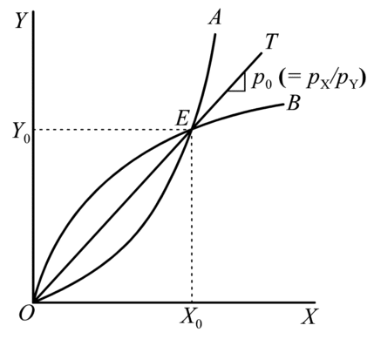

Origins of “Offer Curve”
Diagram:

Slide 48
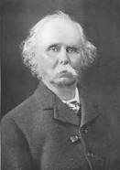
Origins of “Offer Curve”
Substance:
Marshall (1923)
But as with M-L Condition, he did the work before 1879.
He said credit should be shared with others, including
Auspitz und Lieben. 1879. Théorie des Preises

Slide 49
Origins of “Offer Curve”
The name:
Marshall called his two curves only OE and OG (for England and Germany)
He used “offer” only once: “E will be prepared to offer only OM′′ of her bales in return for P′′M′′ bales from G.”

Slide 50
Origins of “Offer Curve”
The name -- my best candidate for having named it:
Edgeworth (1894) (a 3-part article)
In Part II, he showed the curves, using the verb “offer.”
In Part III, referring to Auspitz und Lieben, he said
“Accordingly their supply- or offer- curve is never inelastic in our sense of the term....”

Slide 51
Origins of “Offer Curve”
The name -- others who deserve credit:
Bowley (1924), who explicitly applied it to trade
Lerner (1936) “The Symmetry between Import and Export Taxes”
Used it extensively for his analysis in his still widely-cited paper

Slide 52
Origins of “Terms of Trade”

Slide 53
Origins of “Terms of Trade”
Definition
The relative price, on world markets, of a country’s exports compared to its imports
Most commonly, if
P_{X} = price of exports
P_{M} = price of imports
then
TT = P_{X}/P_{M}

Slide 54
Origins of “Terms of Trade”
Substance and Name
Marshall, Alfred. 1923. Money, Credit and Commerce
(For countries E and G,)
“the amounts to which E and G would be severally willing to trade at various 'terms of trade'; or, to use a phrase which is more appropriate in some connections, at various 'rates of exchange.”

Slide 55
Origins of “Terms of Trade”
Was Marshall the first?
Taussig (1927) says yes.
Mill (1848) did not use the phrase
I’ve not checked all in between

Slide 56
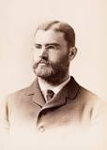
Origins of “Terms of Trade”
Alternative (or more precise) definitions
Taussig (1927)
Preferred the term “barter terms of trade”
Also defined
“Net barter terms of trade”
“Gross barter terms of trade”
(These differ if trade is not balanced.)

Slide 57
Origins of “Terms of Trade”
“Net barter terms of trade”
NBTT = P_{X}/P_{M}
P_{X} = price of exports
P_{M} = price of imports
“Gross barter terms of trade”
GBTT = Q_{M}/Q_{X}
Q_{X} = quantity of exports
Q_{M} = quantity of imports

Slide 58
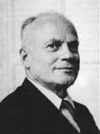
Origins of “Terms of Trade”
Alternative (or more precise) definitions
Viner (1937) said classical economists cared about exchange of factors, as well as goods
Thus defined
Single factoral terms of trade
Double factoral terms of trade

Slide 59
Origins of “Terms of Trade”
“Single factoral terms of trade”
SFTT = NBTT×A_{X} = (P_{X}/P_{M})×A_{X}
A_{X} = own factor productivity producing exports
“Double factoral terms of trade”
DFTT = NBTT×A_{X}/A_{M} (P_{X}/P_{M})×(A_{X}/A_{M})
A_{M} = foreign factor productivity producing imports

Slide 60
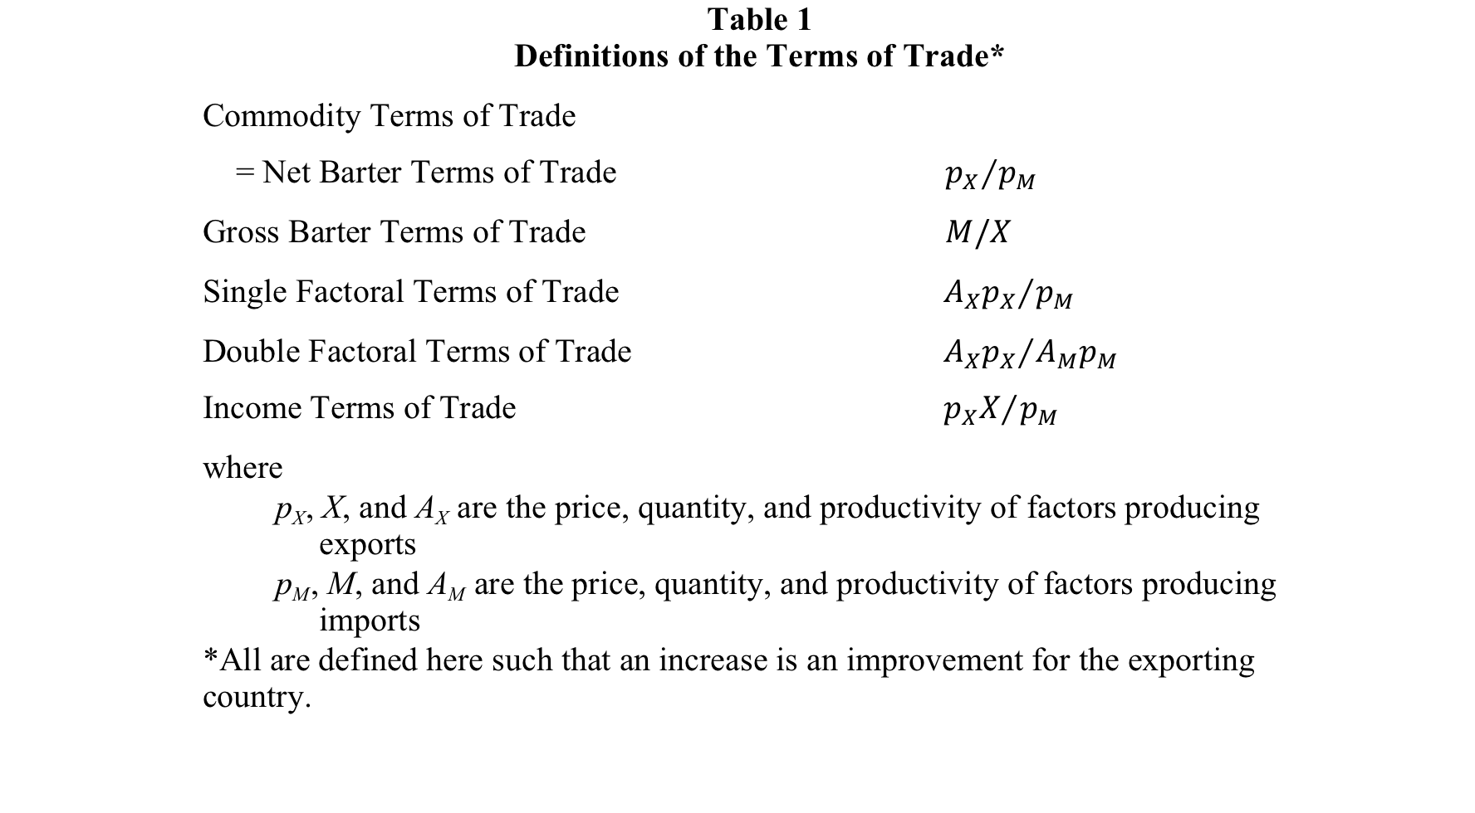

Slide 61
Meaning of “Terms of Trade”
Another ambiguity arose more recently when scholars of International Finance defined TT
NOT as P_{X}/P_{M}
But as P_{M}/P_{X} !

Slide 62
Meaning of “Terms of Trade”
History
Early writers didn’t need to be explicit:
they spoke of TT “improving” or “deteriorating” and that was clear
They didn’t assign it a number or graph it, so didn’t need to define it further

Slide 63
Meaning of “Terms of Trade”
History
Taussig (1927) first spoke of TT of a country
“The net barter terms of trade are then 9.8 wheat = 11 ½ linen”
Later included graphs of TT, which defined it as P_{M}/P_{X}

Slide 64
Meaning of “Terms of Trade”
History
Viner (1937) reversed this
“This reverses Taussig’s procedure, where a rise in the index indicates an unfavorable movement of the terms of trade. No question of principle is involved, but it seems to me to be more convenient to represent favorable movements of the indices by rising indices.”

Slide 65
Meaning of “Terms of Trade”
History
Since Viner, most writers followed his example, using P_{X}/P_{M}
But around 1980, writers in International Finance began sometimes to use P_{M}/P_{X}

Slide 66

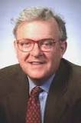
Meaning of “Terms of Trade”
History
Obstfeld (1980):
“… where τ denotes the terms of trade, defined as the price of foreign consumption goods in terms of home goods”
Obstfeld (1981):
Defined p as the terms of trade, then had: “a rise from p to p' in the relative price of the foreign good”
Obstfeld may have been following Dornbusch (1976)

Slide 67
Meaning of “Terms of Trade”
History
Since then
Trade economists (as well as development economists) have mostly stuck to P_{X}/P_{M}
International Finance economists (including Obstfeld himself) have used P_{X}/P_{M} sometimes and P_{M}/P_{X} other times.

Slide 68
P_{X}/P_{M} | P_{M}/P_{MX}
1920s
 | Taussig (1927)
1930s
Leontief (1933)
Viner (1937)
Belshaw (1939) | Mauldon & Anderson (1939)
1940s
Benham (1940), Kaldor (1940)
Schiff (1942)
Boulding (1947)
Dorrance (1948)

Slide 69
P_{X}/P_{M} | P_{M}/P_{MX}
1950s
Imlah (1950), Pigou (1950)
Johnson, (1951)
Meier (1952), Samuelson (1952) | Harberger (1952)
Baldwin (1955), Kemp (1955), Kindleberger (1955)
Corden (1957)
1960s
Mundell (1964)
Krueger & Sonnenschein (1967)
1970s
 | *Dornbusch (1976a,b)
*Red is International Finance

Slide 70
P_{X}/P_{M} | P_{M}/P_{MX}
1980s
*Branson & Katseli-Papaefstratiou (1980), *Díaz Alejandro (1980), Findlay (1980), Spraos (1980) | *Obstfeld (1980)
 | *Obstfeld (1981)
*Svensson & Razin (1983)
Diewert & Morrison (1985), *Persson & Svensson (1985), Sapsford (1985) | *Svensson (1985)
*Ahmed (1987) | *Frenkel & Razin (1987)
Grilli & Yang (1988) | *Ostry (1988)
Cuddington & Urzua (1989) | *Sen & Turnovsky (1989)

Slide 71
P_{X}/P_{M} | P_{M}/P_{MX}
1990s
Powell (1991), Sarkar & Singer (1991)
 | *Ostry & Reinhart (1992)
Bleaney & Greenaway (1993), Shiells & Reinert (1993)
*De Gregorio & Wolf (1994), *Gruen & Wilkinson (1994) | *Backus et al. (1994)
*Amano & van Norden (1995), *Mendoza (1995), *Obstfeld & Rogoff (1995)
*Obstfeld & Rogoff (1996)
Bagwell & Staiger (1999)

Slide 72
P_{X}/P_{M} | P_{M}/P_{MX}
2000s
*Broda (2001), Hadass & Williamson (2001)
Kohli (2004)
Kaplinsky (2006)
Blattman et al. (2007) | *Corsetti et al. (2007)
 | *Kehoe & Ruhl (2008)
*Aghion et al. (2009), Epifani & Gancia (2009), Spatafora & Tytell (2009)

Slide 73
P_{X}/P_{M} | P_{M}/P_{MX}
2010s
*Choudhri & Schembri (2010)
*Crucini et al. (2011)
*Aizenman et al. (2012), Hanson (2012) | *Berka et al. (2012)
Feenstra et al. (2013) | *Jacob & Peersman (2013)
Caliendo & Parro (2015)

Slide 74



Origins of “Terms of Trade”
One of the first that I noticed was:
Backus, David K., Patrick J. Kehoe, and Finn E. Kydland. 1994. "Dynamics of the Trade Balance and the Terms of Trade: The J-Curve?" American Economic Review
“The terms of trade, in this paper, is the relative price of imports to exports…”

Slide 75

Meaning of “Terms of Trade”
Why the difference?
Obstfeld e-mail:
“I suspect this comes from the monetary approach to the exchange rate/bop. Monetary neutrality means that when the money stock rises, all prices rise, including that of foreign exchange. Easy to remember.”
Itskhoki e-mail:
“In International Macro, it is convenient to have nominal and real exchange rates and the terms of trade to be positively correlated.”

Slide 76

Meaning of “Terms of Trade”
Why I prefer P_{X}/P_{M}
It’s what I’ve always done.
As Viner said, it feels right to have a rise in the terms of trade be associated with rising welfare.
Most countries export far fewer products than they import, often relying on only one. With P_{X}/P_{M} the terms of trade is the price of that product, not an index of prices of all others.

Slide 77
Origins of “Terms of Trade”
Because of this ambiguity in meaning, it is best
Not to say that the terms of trade “rises” or “falls”
Better to say it “improves” or “deteriorates”

Slide 78
Topics Skipped for Grinnell
Dixit-Stiglitz utility
Lerner diagram
Marshall-Lerner condition

Slide 79
Origins of “Dixit-Stiglitz utility”

Slide 80
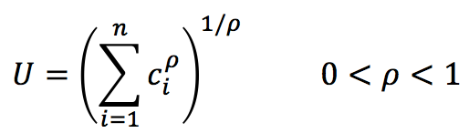
Origins of “Dixit-Stiglitz utility”
where n is variable.
This is the innovation. The rest is just CES.

Slide 81
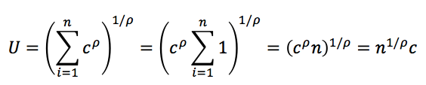

Origins of “Dixit-Stiglitz utility”
The role of variety, n:
If c_{i} = c, i=1,…,n,
Thus utility rises with n –
“Preference for Variety” –
and by more the smaller is σ.

Slide 82
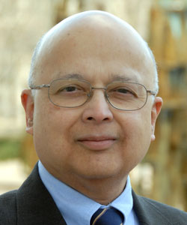
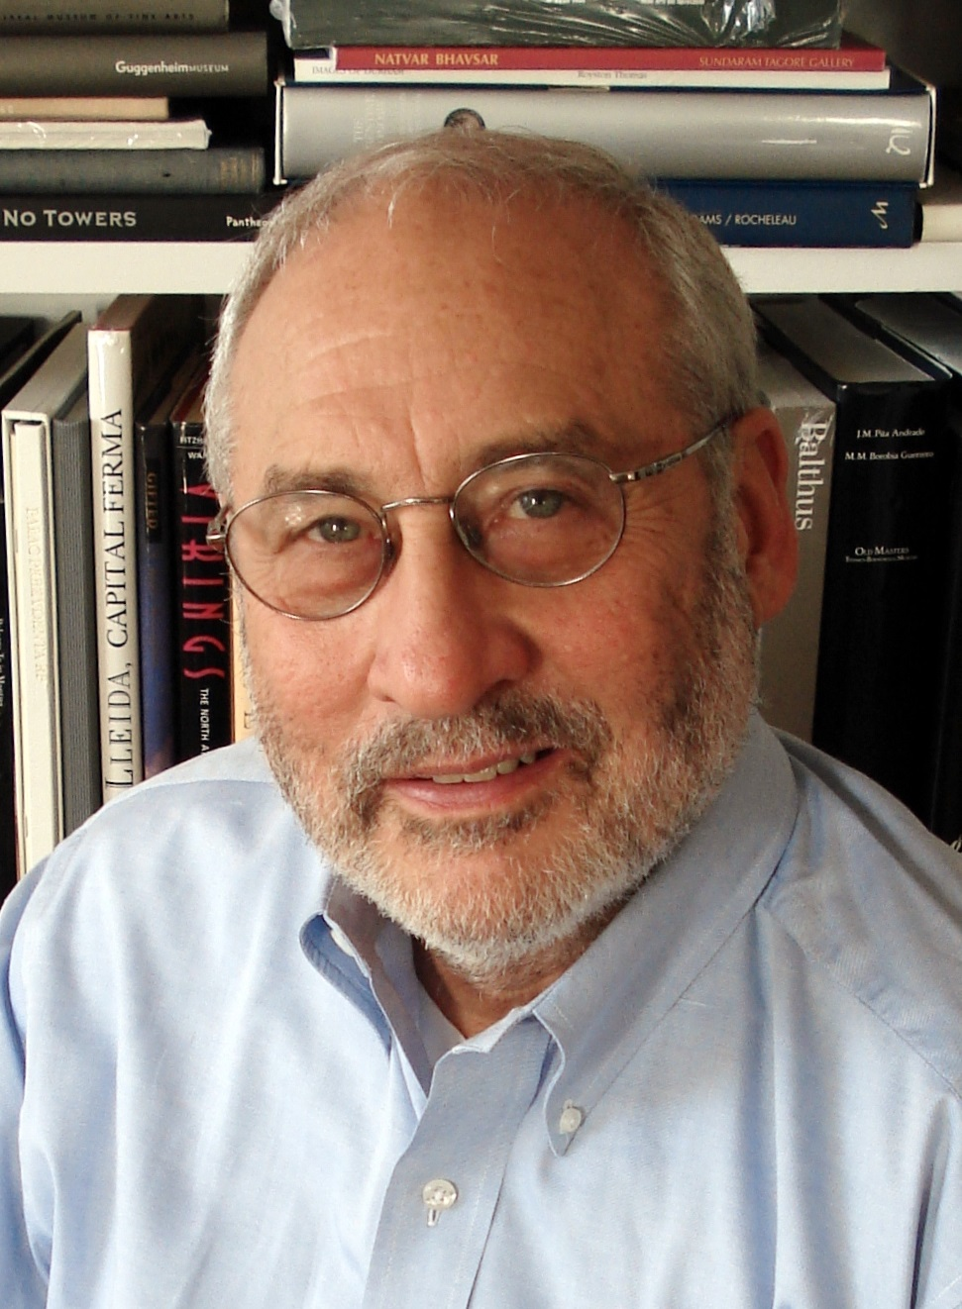
Origins of “Dixit-Stiglitz utility”
Due to:
Dixit, Avinash K. and Joseph E. Stiglitz. 1977. “Monopolistic Competition and Optimum Product Diversity,” American Economic Review 67(3), June, pp. 297-308.

Slide 83

Origins of “Dixit-Stiglitz utility”
But also due to:
Spence, Michael. 1976. “Product Selection, Fixed Costs, and Monopolistic Competition,” Review of Economic Studies 43(2), June, pp. 217-235.
Hence “Spence-Dixit-Stiglitz”

Slide 84


Origins of “Dixit-Stiglitz utility”
Dixit and Stiglitz (1977)
Started with
Then used mostly
Thus D-S also included a second sector, used as numeraire.

Slide 85
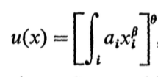
Origins of “Dixit-Stiglitz utility”
Spence (1976) was more complex (for me) but Neary (2000) said he assumed quasi-linear preferences. What I see in Spence, among several specifications, is

Slide 86
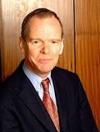

Origins of “Dixit-Stiglitz utility”
D-S also considered special cases that included
CES form for V
Symmetry of V in x_{i}
Cobb-Douglas form for U
Neary (2000) says these have become standard, but because D-S never used all 3 together, this should be called “Dixit-Stiglitz lite”:
(As in the second form above.)

Slide 87
Origins of “Dixit-Stiglitz utility”
In fact, later users have often omitted the numeraire good, x₀, or replaced it with other goods.
The symmetric CES with variable n has become common, as
Dixit-Stiglitz utility
or sometimes
Dixit-Stiglitz subutility

Slide 88
Origins of “Dixit-Stiglitz utility”
The name
Not until 1987 did these names appear in the published literature, but then by more than one author. It was used increasingly after that.
Before then it was frequent for authors to build on the “(Spence-)Dixit-Stiglitz model”
Krugman (1979, 1980) said his formulation was “borrowed from” or “derived from” “recent work by Dixit and Stiglitz (1977)”

Slide 89
Origins of “Dixit-Stiglitz utility”
Application to production was introduced by
Ethier, Wilfred J. 1982. "National and international returns to scale in the theory of international trade," American Economic Review, 72(3), (June), pp. 389-405.
He cited Dixit-Stiglitz and Dixit-Norman, as well as Krugman and others.
His purpose was to “treat the differentiated producer goods central to my own theory.”

Slide 90

Origins of “Dixit-Stiglitz utility”
Ethier’s formulation:
Thus he had a second parameter, α, for the role of variety.

Slide 91

Origins of “Dixit-Stiglitz utility”
Variety in Dixit-Stiglitz and Ethier compared:
If x_{i} = x, i=1,…,n, Ethier’s becomes
so that an equal rise in n and fall in x (keeping total quantity nx constant) raises M to the extent that α>1.

Slide 92

Origins of “Dixit-Stiglitz utility”
Ethier’s reduces to Dixit-Stiglitz if
Thus since ρ < 1, DS implies α > 1.
Note that Either
Made the benefit of variety independent of the elasticity of substitution, unlike DS, and
Left the benefit of variety open to estimation.
Ethier’s example was followed later by Benassy (1996), who was followed in turn by Acemoglu, Antras, and Helpman (1999).

Slide 93
Origins of “Lerner diagram”

Slide 94
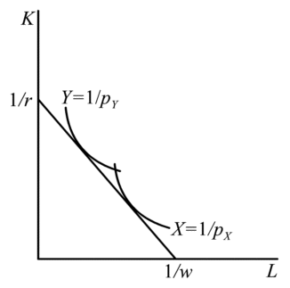
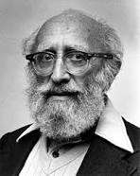
Origins of “Lerner diagram”
Diagram:

Slide 95
Origins of “Lerner diagram”
Diagram was first published in Lerner, Abba P. 1952. "Factor Prices and International Trade," Economica
But Lerner first drew it in an unpublished seminar paper in 1933.
That paper was reproduced in 1952 “as it was originally written,” according to the journal editor.

Slide 96
Origins of “Lerner diagram”
First noticed in print by Findlay and Grubert. 1959. They cited Lerner, but never called it the “Lerner diagram.”

Slide 97


Origins of “Lerner diagram”
Findlay, Ronald and Harry Grubert. 1959. "Factor Intensities, Technological Progress and the Terms of Trade," Oxford Economic Papers

Slide 98
Origins of “Lerner diagram”
First to call it the “Lerner diagram” was Findlay 1971.
Findlay, Ronald. 1971. "Comparative Advantage, Effective Protection and the Domestic Resource Cost of Foreign Exchange," Journal of International Economics

Slide 99
Origins of “Lerner diagram”
Others – apparently before Findlay 1971 -- have called it the “Lerner-Pearce diagram,” due to Pearce, Ivor F. 1952. "The Factor Price Equalization Myth," Review of Economic Studies
That uses unit isoquants, not unit-value isoquants, and thus cannot do what the true Lerner diagram is able to.

Slide 100
Origins of “Marshall-Lerner Condition”

Slide 101
Origins of “Marshall-Lerner Condition”
The condition:
η_{X} + η_{M} > 1
η_{X}, η_{M} are the demand elasticities for a country's exports and imports
Condition for three different things:
Stability of international exchange of goods
Devaluation to improve the trade balance
Stability of the market for foreign exchange

Slide 102
Origins of “Marshall-Lerner Condition”
Substance
Marshall, Alfred. 1923. Money, Credit and Commerce
In the context of offer-curve stability (of international exchange of goods)
“elasticity of demand of each country…be on average to be less than one half.”
had done much of the work between 1869 and 1873, privately printed & circulated in 1879.
[So he published 50 years later. Wow!]

Slide 103
Origins of “Marshall-Lerner Condition”
Substance
Lerner, Abba P. 1944. The Economics of Control: Principles of Welfare Economics
Context: Stability of full employment in Keynesian model where net exports are part of aggregate demand.
Thus, will fall in prices (or currency depreciation) cause net exports to rise or fall?
“The critical point is where the sum of the elasticity of demand for imports plus the elasticity of demand for exports is equal to unity.”

Slide 104
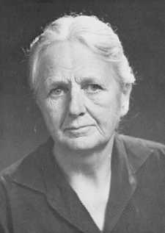
Origins of “Marshall-Lerner Condition”
Substance
Robinson?
Robinson, Joan. 1937. Essays in the Theory of Employment
Same question as Lerner, but her answer was:
k{[ε_{f}(1+η_{h})/(ε_{f}+η_{h})] − Ip[η_{f}(1−ε_{h})/(η_{f}+ε_{h})]} > 0
(Notation is different. ε_{f ,}ε_{h} are the demand elasticities.)
This becomes the M-L condition with balanced trade and infinite supply elasticities, but Robinson didn’t mention this until her 1947 revision.
So no.

Slide 105
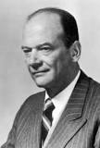
Origins of “Marshall-Lerner Condition”
Name
Condition was cited by others – Polak (1947), Haberler (1949) – but not by that name.
Polak: “the well-known formula”
Haberler: “Lerner condition” (although he acknowledged both Marshall and Robinson)

Slide 106
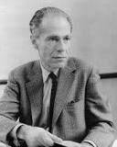
Origins of “Marshall-Lerner Condition”
Name: First was
Hirschman, Albert O. 1949. "Devaluation and the Trade Balance: A Note," Review of Economics and Statistics
His point was that M-L is wrong for improving a non-zero trade balance:
“Our results permit the following conclusions:
(a) The "Marshall-Lerner" condition for devaluation to have a favorable effect on the trade balance (sum of the two elasticities larger than unity) holds only when imports are equal to exports.”

Slide 107
Additional Slides for Possible Later Use

Slide 108
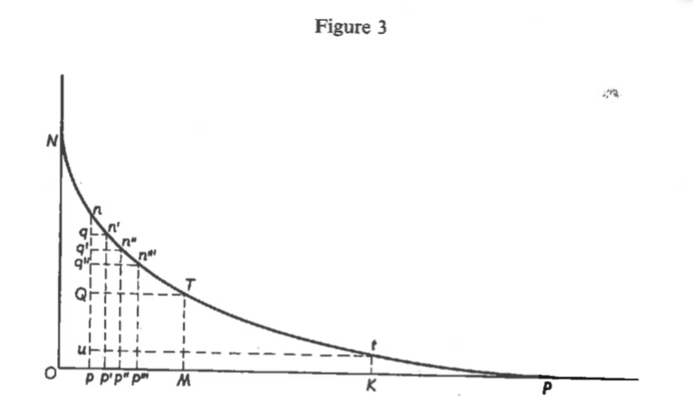
Dupuit 1844, Fig 3, p. 282

Slide 109
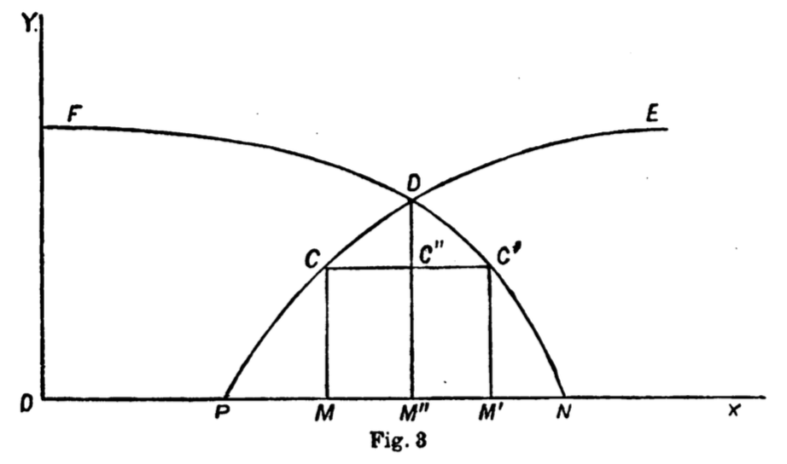
Jenkin 1870-71, Fig 3, p. 113

